Slide 1

RevOps Data Analyst Case Study
PTV Logistics GmbH – Bowtie Metrics & GTM Performance
A comprehensive analysis of Go-to-Market models, department mapping, KPI frameworks, and tool integration strategies for a logistics software company.

Slide 2






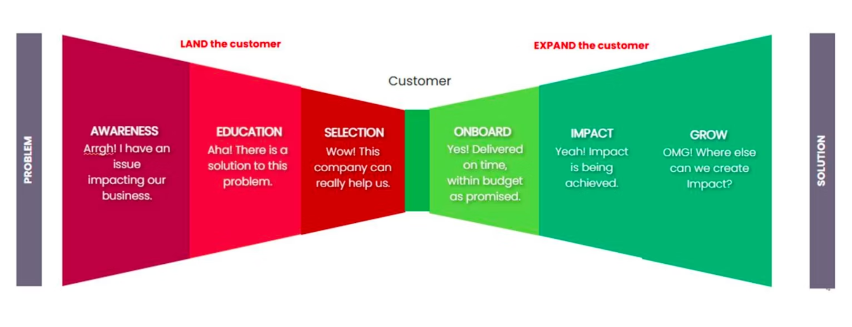
The Bowtie Model: Customer Journey Framework
Awareness
People and companies discover your solution through marketing channels and campaigns.
Education
Prospects understand the problem and how your solution addresses their needs.
Selection
Sales process including negotiations, quotations, and closing the deal.
Onboard
Customer implementation and go-live after purchase completion.
Impact
Active product usage with measurable success and value creation.
Grow
Renewals, upselling, and cross-selling to existing customers.
The bowtie framework divides the journey into Customer Acquisition (left) and Customer Development (right), enabling seamless metric measurement across all stages.

Slide 3

GTM Models & Department Mapping
Customer Acquisition
Customer Development
Awareness & Education
Onboard & Implementation
Marketing: Demand generation, content creation, campaign execution
Marketing Ops: Tracking implementation, lead scoring, data quality management
Content Team: Educational materials and thought leadership
Professional Services: System setup and go-live execution
Customer Success: Handover coordination and initial support
Impact & Growth
Selection & Qualification
Customer Success: Adoption monitoring and health scoring
Support: Ticket resolution and problem solving
Account Management: Renewals and expansion opportunities
SDR/BDR: Initial qualification and SQL generation
Sales/Account Executives: Deal management and closing
Sales Engineering: Technical validation and product demos

Slide 4

Marketing KPIs: Awareness & Education
New Leads (Count)
Cost per Lead (CPL)
Calculation: Number of new contacts created in the reporting period
Calculation: Total marketing expenses ÷ New leads
Why it matters: Evaluates marketing efficiency and budget optimisation opportunities.
Why it matters: Measures the effectiveness of demand generation campaigns and top-of-funnel activity.
MQLs (Count)
Lead to MQL Conversion
Calculation: Number of leads with status = Marketing Qualified Lead
Calculation: MQLs ÷ Total leads
Why it matters: Reveals scoring model accuracy and content relevance to target audience.
Why it matters: Indicates lead quality and marketing-to-sales alignment effectiveness.

Slide 5
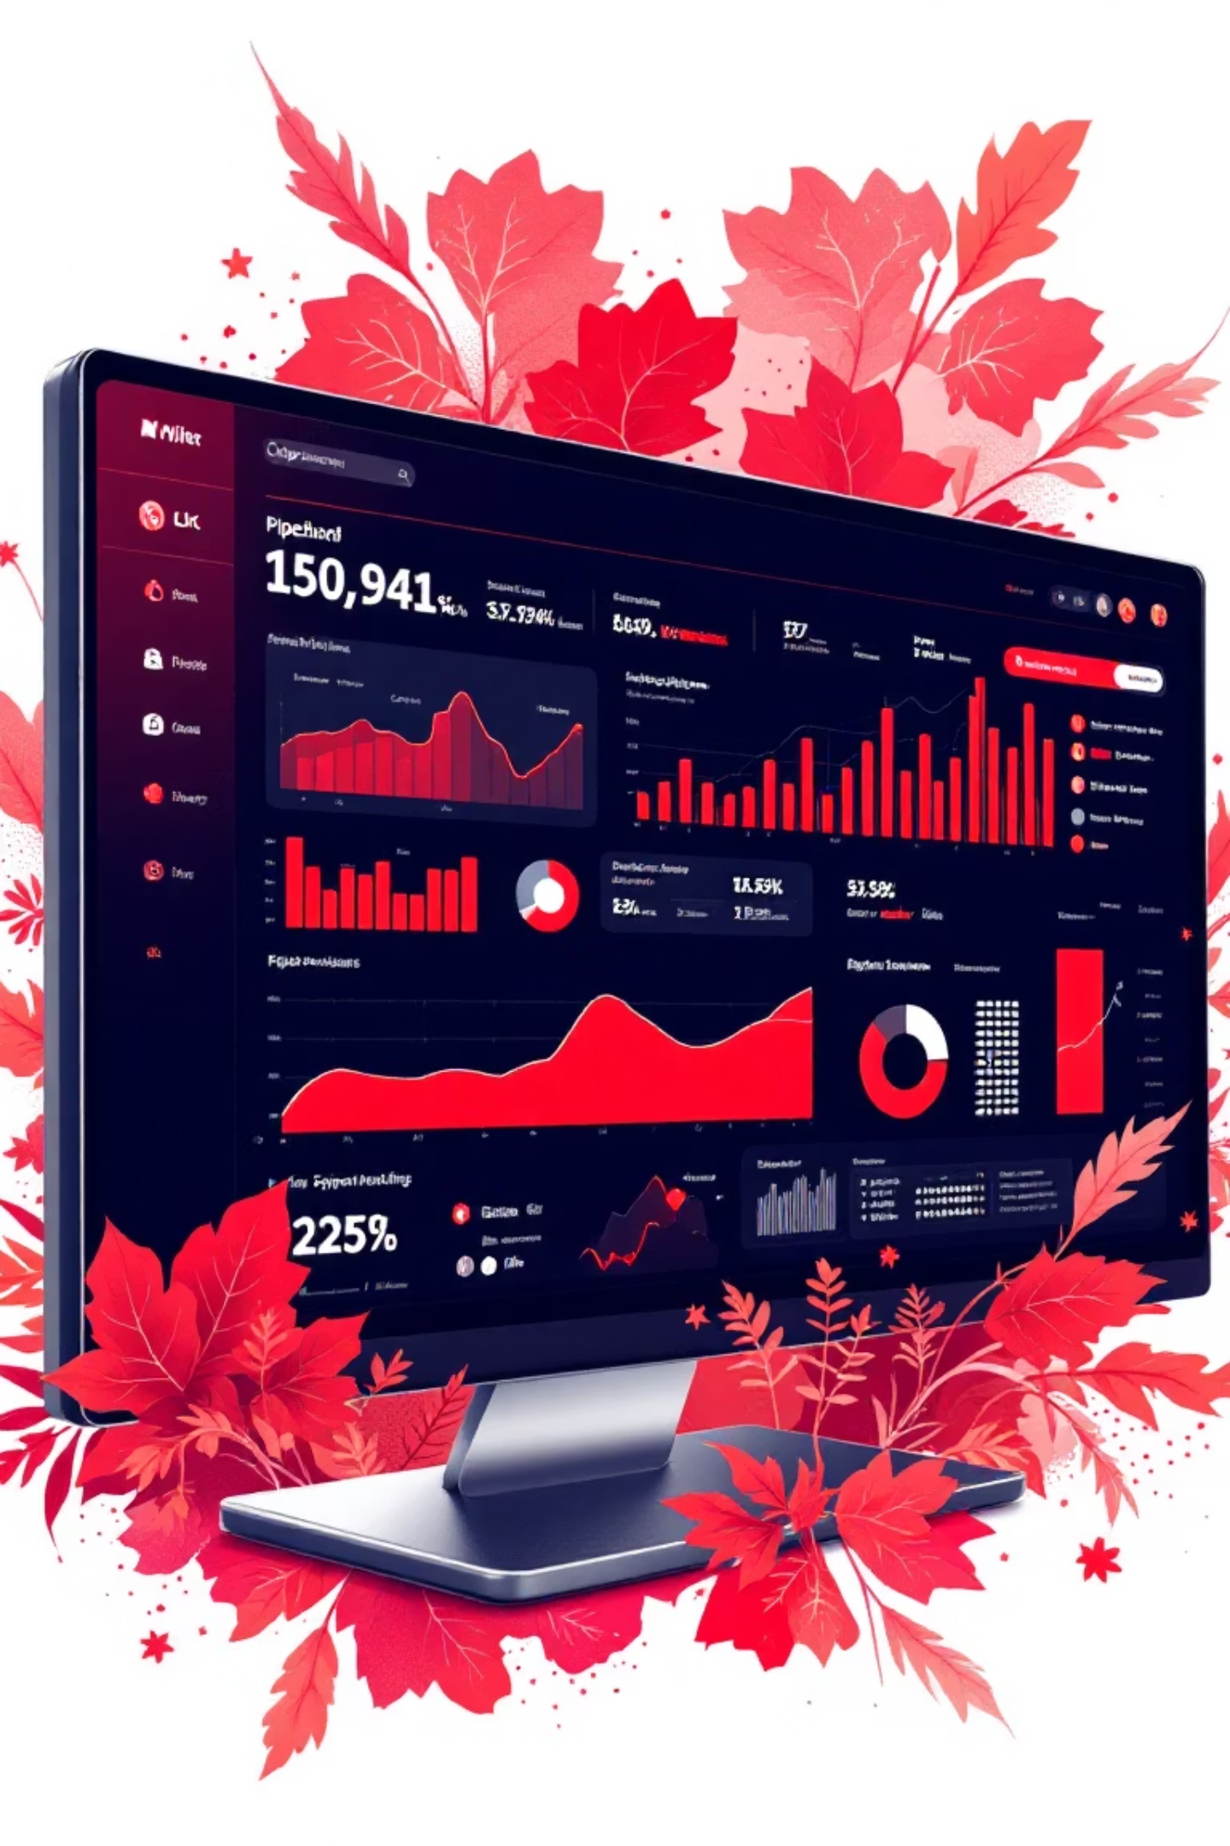
Sales KPIs: Selection & Closing
SQLs (Count)
1
Calculation: Number of leads with status = Sales Qualified Lead
Insight: Measures SDR effectiveness in identifying sales-ready opportunities.
MQL to SQL Conversion Rate
2
Calculation: SQLs ÷ MQLs
Insight: Highlights lead quality issues or sales qualification criteria misalignment.
Win Rate
3
Calculation: Won deals ÷ (Won + Lost deals)
Insight: Reflects competitive positioning, sales execution quality, and product-market fit.
Sales Cycle Length
4
Calculation: Average (Close date − Opportunity creation date)
Insight: Identifies bottlenecks in the sales process and forecasting accuracy.

Slide 6
Post-Sales KPIs: Onboard, Impact & Grow
Time to Go-Live
On-Time Onboarding
Calculation: Average (Go-live date − Close won date)
Calculation: Onboardings within SLA ÷ Total onboarding starts
Value: Tracks implementation efficiency and time-to-value delivery speed.
Value: Ensures SLA commitments are met and customer expectations are managed.
Adoption Rate
Time to First Value
Calculation: Active accounts ÷ Total accounts (active in last 30 days)
Calculation: Average (First value date − Go-live date)
Value: Measures product engagement and value realisation across the customer base.
Value: Critical metric for reducing churn risk and accelerating ROI.
First Response Time
Ticket Reopen Rate
Calculation: Average (First response − Ticket creation)
Calculation: Reopened tickets ÷ Solved tickets
Value: Drives customer satisfaction and prevents issue escalation.
Value: Indicates solution quality and support effectiveness gaps.
Net Revenue Retention
Renewal Rate
Calculation: (Starting ARR + Expansion − Churn − Contraction) ÷ Starting ARR
Calculation: Renewals won ÷ Renewals due
Value: Ultimate indicator of existing customer revenue health and growth.
Value: Predicts revenue predictability and product stickiness.

Slide 7
Tool Stack Mapping Across the Bowtie
HubSpot
Dynamics 365
Chargebee
Primary Use: Awareness, Education stages
Primary Use: Selection stage
Primary Use: Onboard, Grow stages
Sales pipeline management, opportunity tracking, forecasting, and SQL acceptance
Subscription management, ARR tracking, invoicing, and payment processing
Lead generation, MQL qualification, campaign tracking, and lead scoring
Zendesk
Internal Databases
Primary Use: Impact stage
Primary Use: Impact, Grow stages
Support ticket management, first response time, and customer satisfaction tracking
Product usage analytics, feature adoption, and customer health scoring

Slide 8

Data Synchronisation: HubSpot ↔ Dynamics
HubSpot → Dynamics (Forward Sync)
Contact/Company Foundation
Lead Source Attribution
Name, email, company name, domain, phone number, address
Original source, campaign name, UTM parameters, referral URL
Lifecycle & Scoring Data
Engagement History
Lifecycle stage, MQL date, lead score, persona, industry
Content downloads, webinar attendance, email opens/clicks
Dynamics → HubSpot (Back Sync)
SQL Status Updates
Opportunity Creation
Outcome Tracking
SQL accepted/rejected, rejection reason, sales owner assignment
Deal value, ACV, close date, stage, probability, pipeline
Close won/lost, won date, lost reason, actual revenue
Sync Direction & Frequency: Bi-directional sync with real-time or near-real-time updates ensures both systems remain accurate. HubSpot drives lead creation; Dynamics drives sales outcomes.

Slide 9
Executive KPIs: CEO-Ready Metrics
$X.XM
X.X:1
XX%
XX days
New ARR from New Deals
Pipeline Coverage
Win Rate
Average Sales Cycle
Focus: Revenue growth and market expansion
Focus: Forecast predictability and pipeline health
Focus: Sales execution quality and competitive positioning
Focus: Speed to revenue and process efficiency
Calculation: Sum of ACV from closed-won opportunities in period
Calculation: Total pipeline value ÷ Sales target
Calculation: Won deals ÷ (Won + Lost deals)
Calculation: Average days from opportunity creation to close
XX%
Net Revenue Retention
Focus: Existing customer health and expansion
Calculation: (Starting ARR + Expansion − Churn − Contraction) ÷ Starting ARR
These five metrics provide a complete view of revenue performance, from acquisition (New ARR, Pipeline Coverage) to execution (Win Rate, Sales Cycle) to retention (NRR).

Slide 10
Key Takeaways & Recommendations
End-to-End Visibility
Departmental Accountability
Implement bowtie metrics to eliminate silos and enable cross-functional collaboration across the entire customer journey.
Assign specific KPIs to each department with clear ownership, targets, and regular review cadences.
Integration Excellence
Executive Alignment
Establish robust bi-directional data sync between HubSpot and Dynamics with defined field mappings and validation rules.
Surface the five CEO-ready KPIs weekly to drive strategic decision-making and rapid issue resolution.
Next Steps: Begin implementation with KPI definition workshops across departments, followed by tool configuration and data quality audits. Establish monthly review cycles to identify improvement opportunities.

